Slide 1
Machine Learning
Dr.K DeviPriya
Professor
Computer Science and engineering
Lakireddy Bali Reddy College of Engineering
Mylavaram

Slide 2
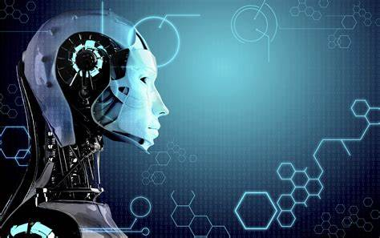
MACHINE LEARNING
MACHINE LEARNING
S

Slide 3
What are the things we are going to see
1)What is Machine Learning?
2)Why we need Machine Learning?
3)Applications of Machine Learning in Real World?
4)Devloping Application using Machine Learning

Slide 4
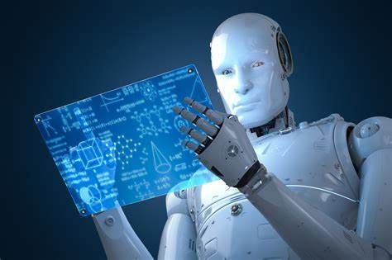
What is machine learning?
Machine learning is a "field of study that gives computers the ability to learn without being explicitly programmed."
--→Arthur Samuel

Slide 5
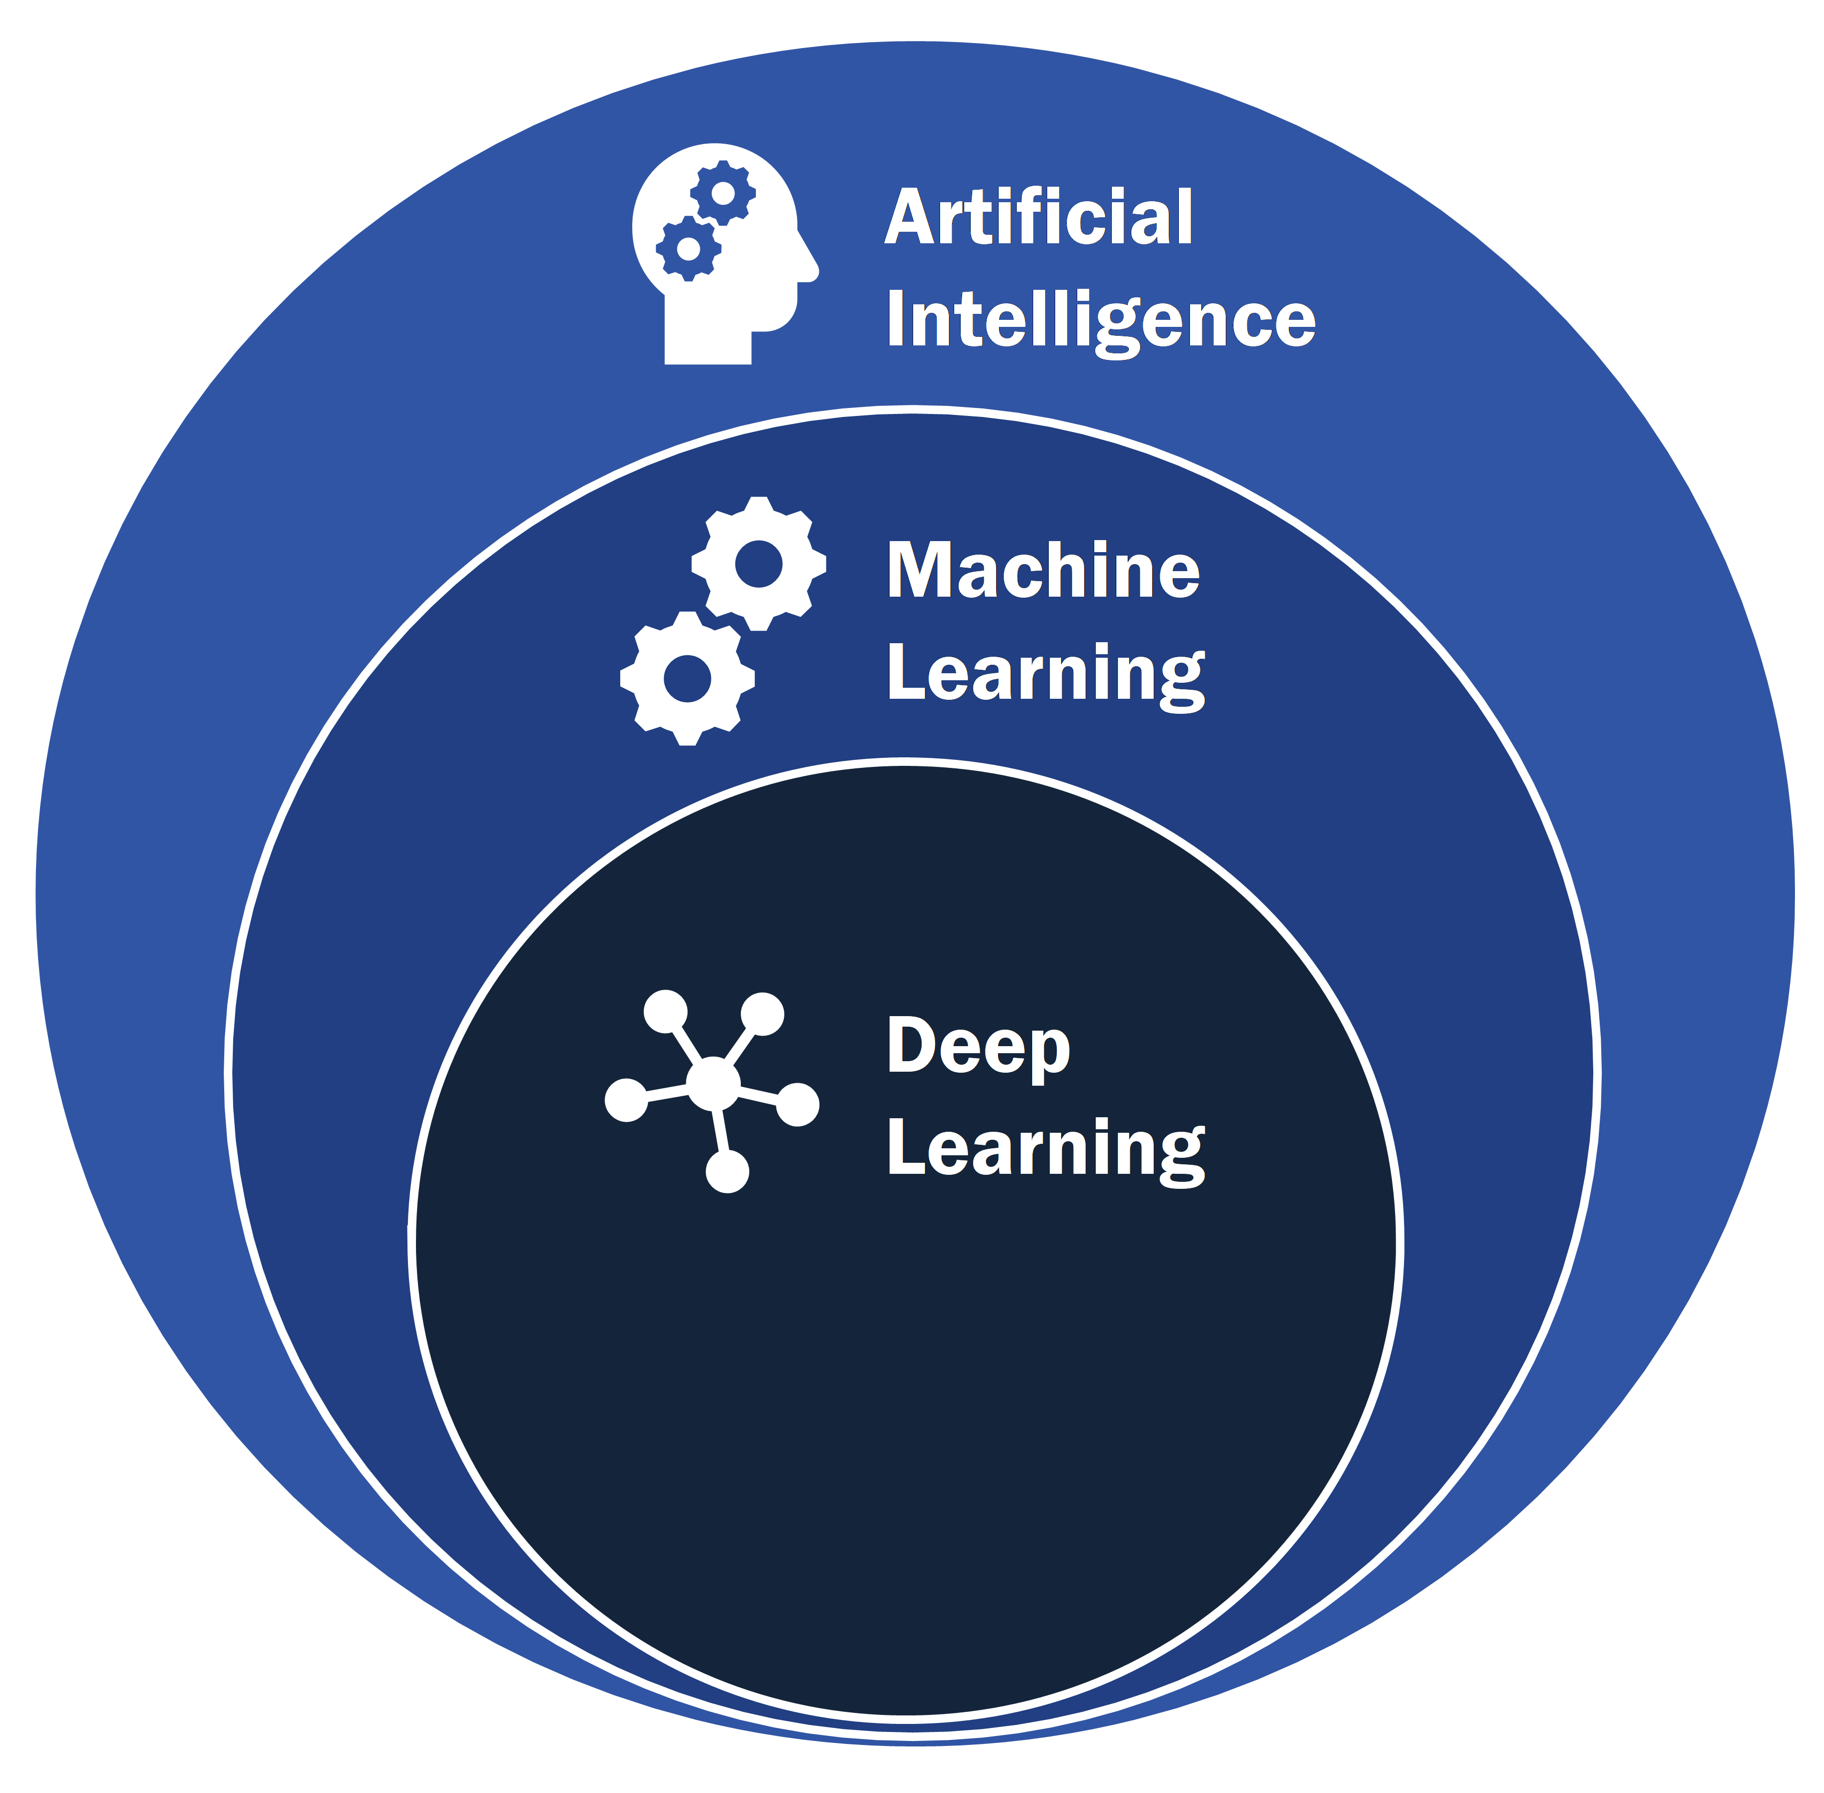

Slide 6
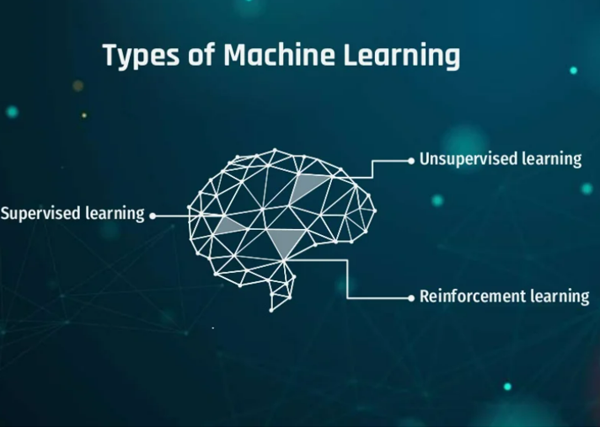

Slide 7
Why we need MACHINE LEARNING?
Machine learning is important because it gives enterprises a view of trends in customer behavior and business operational patterns, as well as supports the development of new products.
Many of today's leading companies, such as Facebook, Google and Uber, make machine learning a central part of their operations.
Machine learning has become a significant competitive differentiator for many companies.

Slide 8
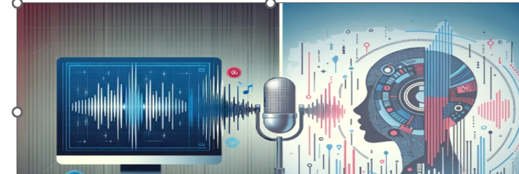
SPEECH RECOGNIZATION

Slide 9

Cyber security

Slide 10
PRODUCT RECOMMENDATIONS

Slide 11
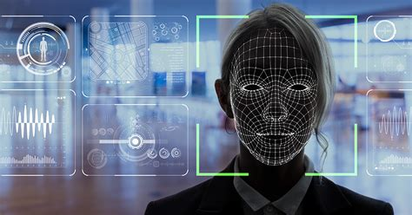
FACe recognization

Slide 12
Medical field

Slide 13
EMAIL SPAM DETECTION

Slide 14
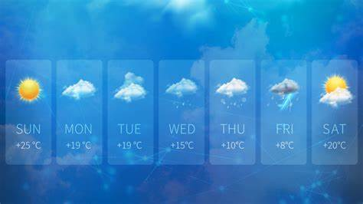
Weather predictions

Slide 15
Advantages of ML
Fast, Accurate, Efficient.
Automation of most applications.
Wide range of real life applications.
Enhanced cyber security and spam detection.
No human Intervention is needed.
Handling multi dimensional data.

Slide 16
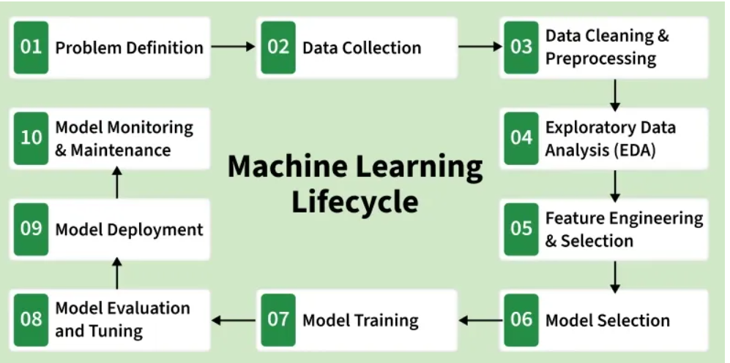
Life Cycle of Machine Learning

Slide 17
scikit-learn: machine learning in Python — scikit-learn 1.8.0 documentation

Slide 18
1.sklearn.model_selection
Used for data splitting and validation
Common functions:
train_test_split()
cross_val_score()
GridSearchCV()
from sklearn.model_selection import train_test_split
X_train, X_test, y_train, y_test = train_test_split(
X, y, test_size=0.2, random_state=42
)

Slide 19
Method | Purpose
train_test_split | Split data
cross_val_score | Evaluate model
KFold | K-fold CV
StratifiedKFold | Balanced folds
LeaveOneOut | Small datasets
GridSearchCV | Best hyperparameters
RandomizedSearchCV | Fast tuning
ShuffleSplit | Random splits
StratifiedShuffleSplit | Balanced random splits

Slide 20
2. sklearn.preprocessing-Data PreProcessing
The sklearn.preprocessing module is used for data cleaning, scaling, normalization, and encoding before training Machine Learning models.
Common classes:
StandardScaler
MinMaxScaler
LabelEncoder
OneHotEncoder
from sklearn.preprocessing import StandardScaler

Slide 21
Types of Preprocessing
Purpose: Normalize data so ML models work correctly
Method | Purpose
StandardScaler | Mean=0, Std=1
MinMaxScaler | Range [0,1]
Normalizer | Unit norm
LabelEncoder | Encode labels
OneHotEncoder | Encode categories
OrdinalEncoder | Ordered categories
Binarizer | Binary conversion
PolynomialFeatures | Feature expansion
PowerTransformer | Normalize distribution
FunctionTransformer | Custom transform

Slide 22
Choose Models-
Linear Models- sklearn.linear_model
LinearRegression-
LogisticRegression
RidegeRegreesion
LassoRegression
TreeModels-sklearn.tree
DecisionTreeRegressor
DecisionTreeClassifer
Neghbors Based Model

Slide 23
Choose Models-
Neghbors Based Models-sklearn.neighbors
KNeighborsClassifer
KNeighborsRegressor
Kernel Based/Margin Based Models-sklearn.svm
SVM
SVC

Slide 24
Evaluation Metrics in Machine Learning
Classification Metrics
Regression Metrics

Slide 25
Evaluation Metrics
sklearn.metrics – Model Evaluation
Purpose: Evaluate classification & regression performance
Common Functions:
  accuracy_score() → Classification accuracy
  precision_score() → Precision
  recall_score() → Recall
  f1_score() → F1 metric
  roc_auc_score() → ROC AUC
  confusion_matrix() → Confusion matrix

Slide 26
Evaluation Metrics
sklearn.metrics – Model Evaluation
Purpose: Evaluate classification & regression performance
Common Functions:
  mean_absolute_error,
  mean_squared_error,
  r2_score

Slide 27
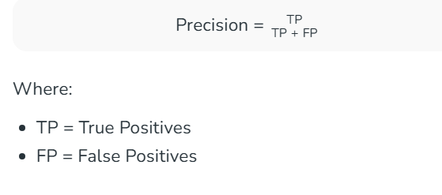
Classfication
Accuracy
Accuracy is a fundamental metric used for evaluating the performance of a classification model. It tells us the proportion of correct predictions made by the model out of all predictions.
Accuracy=TotalNumberofPredictions/NumberofCorrectPredictions​
Precision-It measures how many of the positive predictions made by the model are actually correct.

Slide 28
3. Recall
Recall or Sensitivity measures how many of the actual positive cases were correctly identified by the model.
Recall=TP+FN/TP​
4. F1 Score
The F1 Score is the harmonic mean of precision and recall. It is useful when we need a balance between precision and recall as it combines both into a single number.
F1 Score=2×(Precision+Recall)/Precision×Recall​

Slide 29
Common Methods in scikit-learn Models
fit(X,y)-Train the model on the given dataset-model.predict(X_train,y_train)
Predict(X)-y_pred=model.predict(x_test)
Score(X,y)-model.score(x_test,y_test)

Slide 30
Stepts in Model Creation
Import packages
Load dataset
Preprocess data set
Split dataset
Create model instance
Fit the model
Evaluate the model
Predict New Unseen Samples

Slide 31
Tkinter Module
Tkinter Module in Python
Tkinter is the standard GUI (Graphical User Interface) library for Python.
It is built-in, no extra installation required (import tkinter as tk).
Provides widgets like buttons, labels, text boxes, frames, menus, and more.
Runs on Windows, macOS, Linux.

Slide 32
import
Import Tkinter:
import tkinter as tk

Slide 33
Create MainWindow
root = tk.Tk()
root.title("My App")
root.geometry("400x400")

Slide 34
Add widgets (buttons, labels, entries).
Widget | Usage
Label | Display text or image
Button | Clickable button (command links function)
Entry | Single-line input field
Text | Multi-line text area
Checkbutton | Checkbox
Radiobutton | Radio button
Frame | Container for grouping widgets
Menu | Dropdown menu
MessageBox | Popup dialog for info, warning, error
FileDialog | Open/save file dialog

Slide 35
Add widgets (buttons, labels, entries).
tk.Label(root, text="Enter Age").pack()
tk.Button(root, text="Submit", command=func).pack()

Slide 36
Slide 4: Geometry Managers (Positioning Widgets)
Three types:
pack() → Stack widgets (top, bottom, left, right)

Slide 37
grid() → Arrange in rows and columns
tk.Label(root, text="Age").grid(row=0, column=0)
tk.Entry(root).grid(row=0, column=1)

Slide 38
place() → Absolute positioning
label.place(x=50, y=100)

Slide 39
Event Handling and Commands
Use command parameter in Button to call a function:
def say_hello():
print("Hello!")
tk.Button(root, text="Click Me", command=say_hello).pack()

Slide 40
Retrieve input from Entry:
name = entry.get()
Message Boxes and File Dialogs
MessageBox → Inform, warn, or show errors
from tkinter import filedialog
file_path = filedialog.askopenfilename(filetypes=[("CSV files","*.csv")])

Slide 41
Deep learning?
Deep learning differs from traditional machine learning techniques in that they can automatically learn representations from data such as images, video or text, without introducing hand-coded rules or human domain knowledge.

Slide 42
Deep learning?
Deep neural networks consist of multiple layers of interconnected nodes, each building upon the previous layer to refine and optimize the prediction or categorization.

